Slide 1
What do you hope to gain/learn from this class?
Warm-Up

Slide 2
Write down the key topics you remember from both sports med 1&2.
On a sheet a notebook paper to turn in

Slide 3
Write down anything you would really like to learn about that is related to sports med that maybe has been covered briefly or not covered at all.
Next on that same sheet

Slide 4
What do you look forward to most in working your sport/what did you enjoy most about the sport?
Warm-Up

Slide 5
Sport
Identify all positions for the sport and a description of what their role is, what they may look like (size, height) and how many are on the field/court at once
High School What are rules of the sport related to player safety? (injury time, protective equipment required, penalties/fouls, rules regarding injured players returning)
What is the objective of the sport? What is each team trying to do and how?
How is scoring done?
How are substitutions accomplished?
What injuries are common in this sport?
What are the dimensions of the field/court (LxW)
Overtime rules
3 interesting things about the sport

Slide 6
Warm-Up
Based on the common injuries of your sport from the project, what would you do for them?

Slide 7
Heads up Video
https://www.youtube.com/watch?v=VH2KjItYXUY
-big hit broken dreams

Slide 8
What did you learn from the videos?
Warm-Up

Slide 9
What head injuries do you know of? How can they happen?
Warm-Up

Slide 10
Whats treatment for a nosebleed? Whats the initial difference between a sprained ankle and a potential fracture? What is an example of an EMS situation at a sport rotation? Are you allowed to make return to play decisions for your sports athletes?
Review

Slide 11
What do you feel most confident in with the student hours. What do you feel least confident in doing in student hours? For each explain why and for least confident think of what would help improve confidence.
Warm Up complete on separate sheet to turn in

Slide 12
What is proper treatment for patella subluxation? What can be done for an athlete experiencing heat exhaustion? If an athlete sprains their ankle but can walk, what would treatment be? If an athlete collides heads what would we do if potentially concussed? If an athlete cuts their arm and is bleeding whats proper treatment?
Review

Slide 13
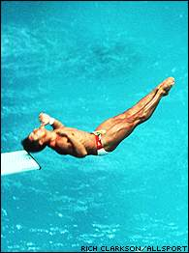
Head Injuries

Slide 14
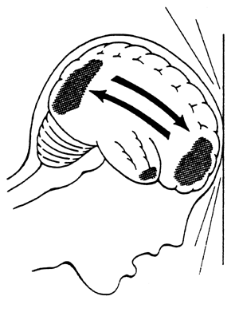
Concussion
the temporary impairment of brain function caused by impact to the head or rotational forces.

Slide 15
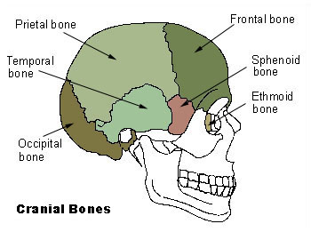
Anatomy- Frontal, Temporal, Parietal, Occipital Bones
Cerebrospinal fluid- fluid around brain, provides proper function, support, and protection to the brain

Slide 16
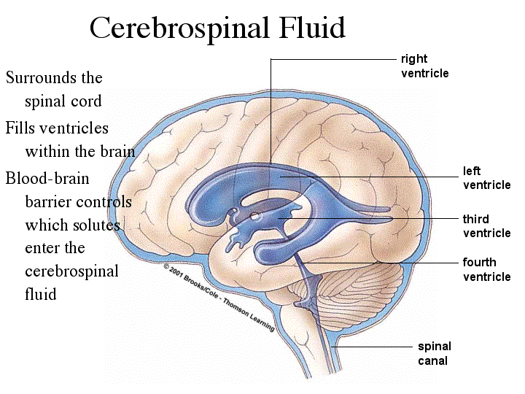

Slide 17
Signs and Symptoms
Nausea, dizziness, headache, vomiting, difficulty speaking, tinnitus, loss of balance, amnesia, possible battle sign, disorientation, confusion, difficulty remembering/concentrating, emotional/irritability, feeling slow, foggy or goofy (out of it), sensitivity to light/noise
Loss of consciousness

Slide 18
Vocab.
Tinnitus- ringing in the ears
Amnesia- difficulty remembering thing (two types)
Retrograde- doesn't remember events prior to injury
Anterograde- doesn’t remember events following injury

Slide 19
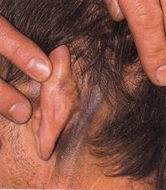
Battle sign- discoloration (bruising) behind the ear. (Sign of major skull injury)

Slide 20
Predisposing Factors
Poor fitting equipment/or equipment not used properly.....mouthguards (little overrated)
-Sport/Risk Football-vs-Volleyball
-Past injury..... If you get one you are up to ____X likely to get another

Slide 21
Risk Factors
Prior concussion(s) 3+ = 3.5x / risk 2 = 2.8x / risk 1 = 1.5x / risk
ADHD, learning disabilities, psychiatric history, migraine, motion sickness.
Age (younger patients take longer to recover)
Genetic Predisposition (Apolipoprotein E (APOE4) genotype)
Female gender

Slide 22
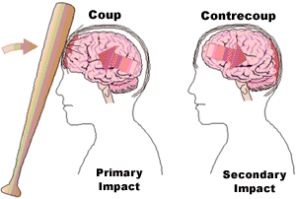
Mechanism
impact to the head or rotational forces.
Coup- Brain injured same side as impact
Contrecoup- injury to the brain opposite the side that received the impact.
Brain is like an egg.....

Slide 23
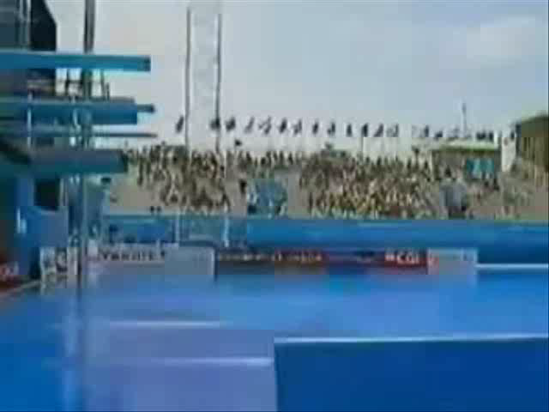

Slide 25
Football hit concussion video

Slide 26
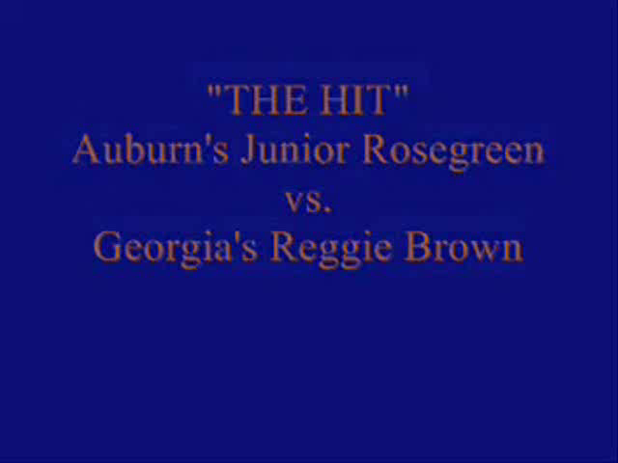
Skateboarded video

Slide 27
Concussion Assesment
Look up the SCAT-5 Concussion exam
We will walk through the eval

Slide 28
Warm-Up
What else can be done to detect, identify and evaluate concussions? What parts of scat do you find challenging?

Slide 29
Review
What is difference between coup/counter?
What are 3 things that can increase your chances of getting a concussion?
What is battle sign?
What are 8 symptoms of a concussion?
What is a concussion?
On the SCAT-5 what sections is the glascow coma scale broken into?

Slide 30
Cranial Nerves
Along with SCAT-5 we want to assess cranial nerves to see if any are affected.
Olfactory, Optic, Oculomotor, trochlear, trigeminal, abducens, facial, vestibulocochlear, glossopharyngeal, vagus, accessory, hypoglossal

Slide 31
With your group for notes
For each cranial nerve identify if it is sensory or motor, what it does, and how you could test it on field/in office.

Slide 32
IMPACT
Take the impact test

Slide 33
Warm-Up
From the IMPACT test what section was the most difficult for you? What section was the easiest?

Slide 34
Review
What are 3 guidelines to give a team before they take the baseline test?
What are different components of the impact test?
What is completed before starting the neurocognitive test on the IMPACT?
What does it mean for the test to be a baseline?

Slide 35
Warm-up
How can you heal a concussion?

Slide 36
Management
Athlete should be evaluated by medical professional
Athlete should be monitored for 24 Hours to make sure symptoms are not worsening
Athlete should not take Meds (unless doctor says)... (if take Meds should be Tylenol or ibuprofen) NO Aspirin!!
Return to play decisions should be made ONLY by a medical professional
If return too soon...

Slide 37
Second impact syndrome
occurs when the athlete’s first concussion was not given enough time to heal and receives another blow to the head.
Can be fatal...
Long term...learning disabilities, personality changes
Primarily seen in high school to college aged kids

Slide 38
Rehabilitation
Rehabilitation is rest, the athlete should not partake in any strenuous activities, and should check in with their Athletic Trainer daily to monitor symptoms
Athlete should avoid physical activity till symptom free. Allowed to walk.
Should avoid texting, computer, video games, loud noises (music, large crowds), cognitive exertion (school work)

Slide 39
Rehab
Rest
Re-evaluation
(Impact or Neuropsychological Testing)
Should test functionally to make sure safe to return… increase in blood pressure

Slide 40
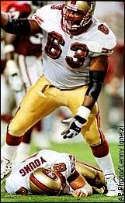
Prevention
Proper fitting & Use of equipment
Reporting concussions even if mild
Proper hitting form...football

Slide 41
Warm-Up
What are 3 takeaways you had from the 30 for 30

Slide 42
Warm-Up
What is benefit of taking Impact test before the season starts? What do you think computer test does?

Slide 43
Baseline Testing
Return to play decisions are easier to make when you have baseline testing.
Baseline testing can tell you when an athlete has returned to normal brain function
We use Impact
Type of Neurophysiology testing

Slide 44
Impact
Test the brain to see where injury/deficits are
Test reaction time and different types of cognitive processing
5 domains are tested and 1 symptom reporting section
Can still be used if have no baseline

Slide 45
Return to play
NCHSAA law that any student thought to or diagnosed with a concussion must have written permission from a Physician to start a return to play program.

Slide 46
Warm-up
What would you tell an athlete who was hit in the head and has a couple concussion symptoms but wants to continue playing?

Slide 47
review
Why especially no asprin?
Why no medicine until doctor says so?
Describe second impact syndrome

Slide 48
Individually or with partner
You are creating a concussion brochure that would be informative for concussions
Should have section on recognizing concussion, how it can happen, 10 symptoms, when it would be emergency
Section on management: what should you do if you are concussed (take home instructions, what they should avoid (medicines)
Last section on return to play: how the process works, when can they start, how long does it take (minimum)

Slide 49
SPRING SPORTS BEGIN!!!!

Slide 50
Warm-Up
What advice would you give a friend who is an athlete and is trying to hide or lie about not having a concussion?

Slide 51
Review
Can the impact test still be used if they don’t have a baseline? How?
What are the 3 balance stances in SCAT?
Why is it important to not give aspirin?
Describe second impact syndrome?
What is each cranial nerve and its function?

Slide 52
Warm-Up
Why do you think it concussion return to plays are gradual instead of immediate?

Slide 53
Review
What are parts of on-field assessment for concussions?
What name did Junior Seau call everyone to be friendly?
How did Junior’s personality change throughout?
Explain how to do the word memory part of the SCAT 5

Slide 54
REVIEW
From video
Where did the video take place
What happened to Jaquan? What went wrong with his initial eval?
What was county’s solution?
What was different about player from Kansas

Slide 55
GFELLER-WALLER ACT
Enacted in 2011
Focus on education, emergency action, and post-concussion management
Required for schools to follow, part of online registration process.

Slide 56
Return to play
· Once an athlete is symptom free for a minimum of 24 hours then the return to play progression can begin
· Day 1: Exertion test & Impact test
· Day 2: Light Aerobic Exercise
· Day 3: moderate-intense exercise and Sport Specific Exercise (Non-contact)

Slide 57
Return to play
Day 4: Non-contact Training Drills (no scrimmage or live play allowed)
Day 5: Full practice.
Day 6: Return to full participation
*** If anytime during the 6 day return to play the athlete’s symptoms return, they will be re-evaluated and will re-do the stage when symptom free***

Slide 58
Individually
Come up with a plan for what they would do for day 3 and day 4 for non-contact practice drills. Be specific for your sport.

Slide 59
Warm-Up
What do you know about CTE?

Slide 60
Review
How many days is it in the RTP to get back to full participation in games?
Before they begin stage 1 what must occur?
What kind of activity do they do day 2?
What do they do day 4?

Slide 61
CTE
Stands for Chronic Traumatic Encephalopathy
Is caused by repeated head trauma
Does not have to be concussive blows to the head
Before it became more notable in football players it was seen in professional boxers

Slide 62
Find out the following for CTE
What happens with CTE? Tau protein builds up in brain and damages brain
What is 1 non-athlete population its been seen in? military
What is treatment for it? No cure, best is to treat symptoms with proper medicine
When can CTE be diagnosed? At this point CTE can only be diagnosed post death

Slide 63
4 Stages of CTE
Stage 1: early on may have headaches and loss of focus
Stage 2: experience depression/mood swings, explosivity, short term memory loss
Stage 3:executive dysfunction, memory loss, explosivity, difficulty with attention and concentration
Stage 4: executive dysfunction, memory loss that develops to severe memory loss with demetia. Many also experience significant loss in attention and concentration

Slide 64
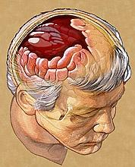
Intracranial Hematoma subdural or epidural
severe bleeding within the brain caused by a blow to the head.
If happens they must drill...or remove part of skull

