Slide 1
Warm UP- start this sheet to continue with next week
What do you hope to gain/learn from this class?

Slide 2
Review
When is the syllabus due?
What is the rule for missed questions on review?

Slide 3
How do you best learn and study?
Warm-Up

Slide 4
Review
Based on Panther creek rules, where should you go at 6:55 bell?
What are 3 examples of lacking academic integrity?
What are 2 positives about social media?
What are 2 negatives about social media?
What is 1 way you as a student can advocate for yourself if falling behind in a class?

Slide 5
SPORTS MEDICINE I Unit 1 Vocabulary
Bandaging and
Taping Techniques

Slide 6
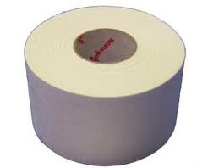
UNIT 1 VOCABULARY
Adhesive/Athletic Tape
Traditionally marketed as non- elastic,
white tape.

Slide 7
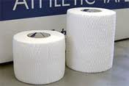
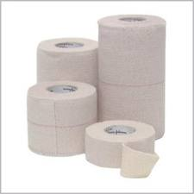
UNIT 1 VOCABULARY
Elastic Athletic Tape
Conforms to the contour of the body part to
which it is applied.

Slide 8
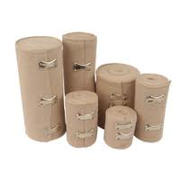
UNIT 1 VOCABULARY
Elastic Wrap
Woven fabric bandage that allows for expansion and contraction of the area to which it is applied.
Used to provide either compression or support to an injured area.

Slide 9
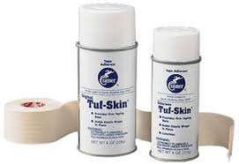
UNIT 1 VOCABULARY
Spray Adherent- Aerosol adherent used prior to applying tape. It helps the tape adhere to the skin.

Slide 10
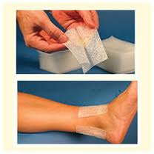
UNIT 1 VOCABULARY
Heel and Lace Pads- Thin foam lubricated pads applied prior to tape that helps decrease friction and the possibility of tape irritation.

Slide 11
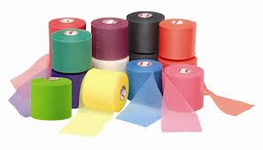
UNIT 1 VOCABULARY
Pre-Wrap/Underwrap- thin roll foam material applied prior to tape to protect the skin.

Slide 12
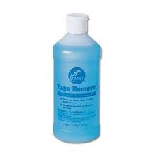
UNIT 1 VOCABULARY
Tape remover
An alcohol based liquid or aerosol for removal of
adherent residue from the skin.

Slide 13
UNIT 1 VOCABULARY
Prophylaxis
Treatment used to help prevent disease
or injury.
Spend 2 minutes with your table and come up with as many prophylactic treatments you can think of for athletics

Slide 14
With a partner on a separate sheet of paper
Look up the article: Prophylactic Ankle Taping and Bracing: A Numbers-Needed-to-Treat and Cost-Benefit Analysis
Summarize the following sections:
background- first few paragraphs on ankle sprain
cost-benefit analysis
tape and brace cost
taping intervention
results- numbers needed to treat
conclusions

Slide 15
Warm Up
What activities do you dislike doing in class, why?

Slide 16
Review
What tape is the most common we use?
Heel and lace pads are designed to do what?
What can elastic wraps provide?
What is more expensive for a season ankle braces or taping?
Is it worth it to prophylactically tape an entire team for a season?

Slide 17
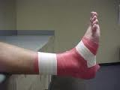
UNIT 1 VOCABULARY
Anchor
Initial strips of tape applied to the area to be
taped. Anchors serve as the foundation on which
the tape application is assembled.

Slide 18
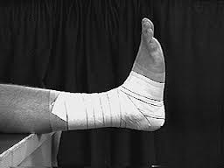
UNIT 1 VOCABULARY
Locking or closing
Final strips of tape applied to secure the tape
application in place.

Slide 19
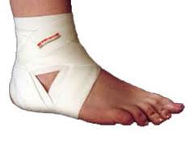
UNIT 1 VOCABULARY
Ankle wrap
Woven cloth wrap used to provide ankle support.
It is 96 inches in length. The wrap is applied to
the ankle with 2 heel locks and 1 figure “8”.

Slide 20
UNIT 1 VOCABULARY
Proximal
Nearer the body’s midline.

Slide 21
UNIT 1 VOCABULARY
Distal
Farthest from the body’s midline.

Slide 22
UNIT 1 VOCABULARY
Movements
Dorsi flexion –toes pointed towards shin
Plantar Flexion –toes pointed away from shin (down)
Inversion –ankle turned in (towards other foot)
Eversion –ankle turned out (away from other foot)

Slide 23
Proximal/Distal
What is more proximal knee or the foot?
What is more distal fingertips or wrist?
What is more proximal elbow or shoulder?
What is more distal hip or the shin?
What is more distal knee or hip?
What is more distal shoulder or wrist?
What is more proximal fingertip or palm?

