Slide 1
Pulse Lab

Slide 2
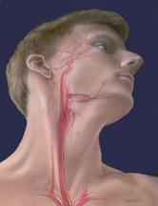
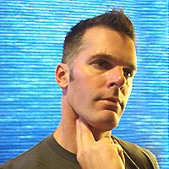
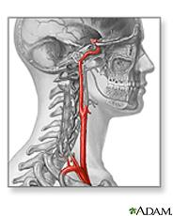
Pulses
Carotid Pulse- Neck (between muscles and throat) ______________ bpm/pulse rate
Supplies blood to the head, neck and brain

Slide 3
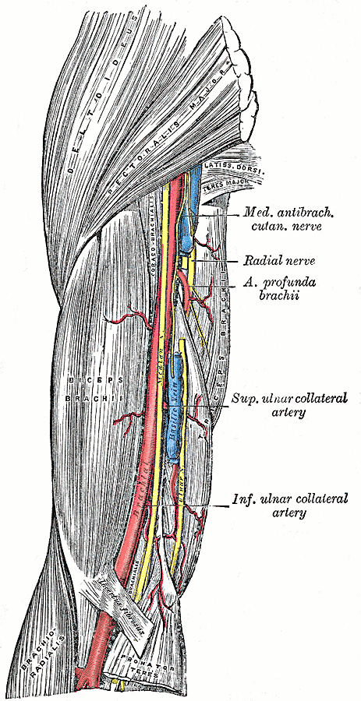
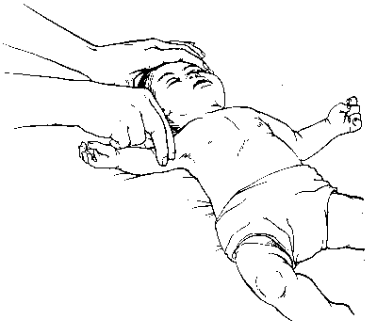
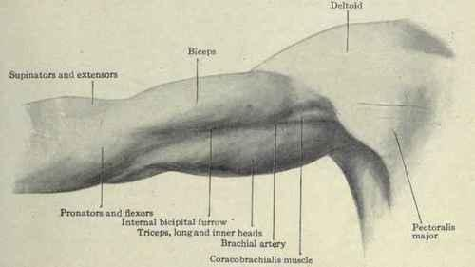
Pulses
Brachial Pulse- upper arm (between Bicep and Triceps) _____________ bpm/pulse rate
Supplies blood to the arm/hand

Slide 4
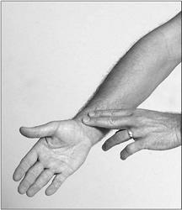
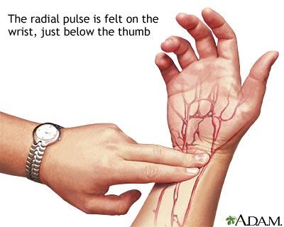
Pulses
Radial Pulse- Wrist (Anterior Lateral side)
______________ bpm/pulse rate
Supplies blood to the hand

Slide 5
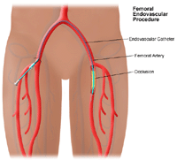
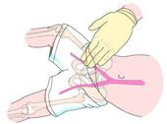
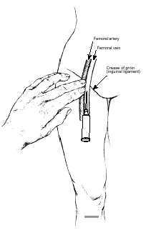
Pulses
Femoral Pulse- in groin- Anterior medial side.
______________ bpm/pulse rate
Supplies blood to the thigh & lower leg

Slide 6
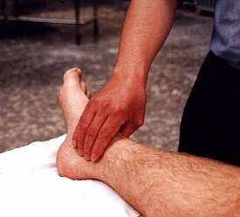
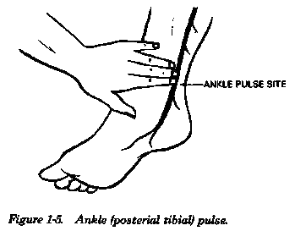
Pulses
Tibial pulse- behind & inferior to medial malleolus (medial ankle bone)
______________ bpm/pulse rate
Supplies blood to the foot

Slide 7
When evaluating an injury what should you look for first? Why?

Slide 8
Review
What are the different injury mechanical forces?
What is difference between sprain/strain?
What causes apophysitis? example
What artery carries blood to the brain?
Which pulse do you check with activity?
What is average pulse rate?

Slide 9
INJURY EVALUATION
Sports Medicine
UNIT 4
Injury Assessment, Recognition, and Management

Slide 10
Primary survey
Checking for ABC’s:
Airway
Breathing
Circulation

Slide 11
Secondary survey
After primary survey is cleared then you will complete secondary survey. Which more specifically looks at the injury.

Slide 12
HIPS/HOPS
History
Inspection/observation
Palpation
Special tests/stress tests

Slide 13
History
Sports Medicine
Has the area been injured before?
How did the injury happen?
What were you doing when the injury happened?
Where does it hurt?
What is the quality of pain?
What is the quantity of pain?
Have you had any previous surgeries to the area?
What previous treatments have been used on the injured area?

Slide 14
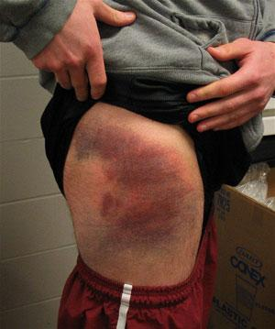
Observation
Sports Medicine
Discoloration (Ecchymosis)

Slide 15
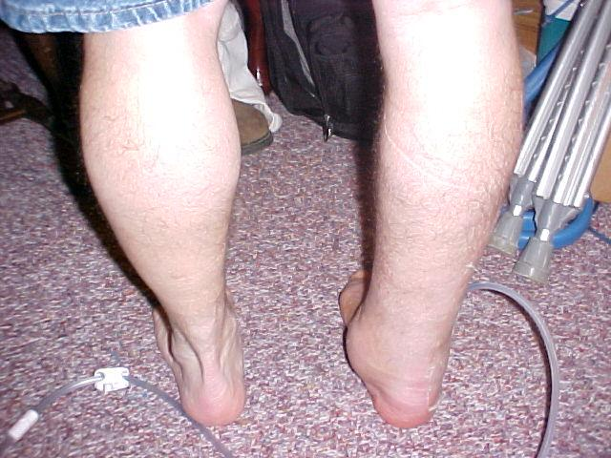
Observation
Sports Medicine
Swelling

Slide 16
Observation
Sports Medicine
Deformity

Slide 17
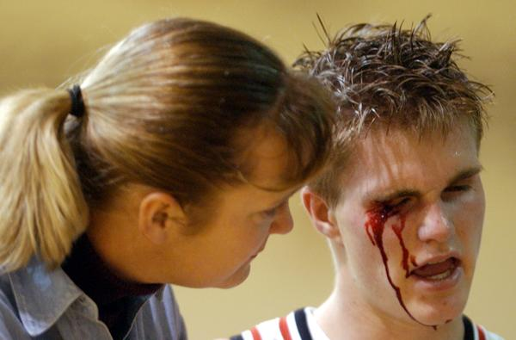
Observation
Sports Medicine
Bleeding

Slide 18
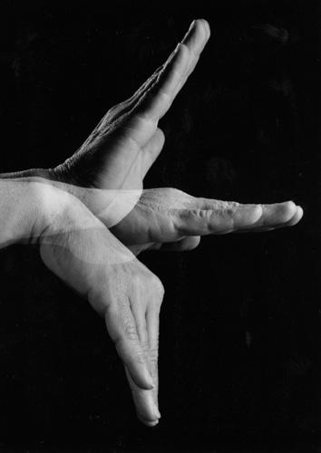
Observation
Sports Medicine
Range of Motion

Slide 19
Observation
Sports Medicine
Scars

Slide 20
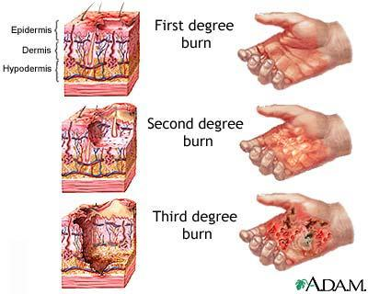
Observation
Sports Medicine
Burns

Slide 21
Observation
Sports Medicine
Expressions denoting pain

Slide 22
Warm-Up
What do you think are part of the palpation and special tests of injury evaluation?

Slide 23
Review
What occurs with myositis ossificans
What happens in arthritis?
What is difference between primary and secondary evaluation?
What is the purpose of the history section?
What are 4 things to observe for?

Slide 24
With Partners
Choose an acute and chronic injury you are interested in and identify what someone may present with for that injury. (History and Observation) be specific.

Slide 25
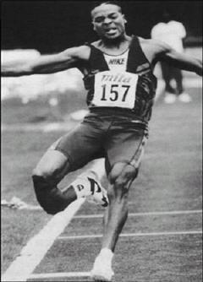
Palpation
Sports Medicine
Deformity

Slide 26
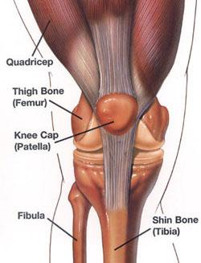
Palpation
Sports Medicine
Point tenderness

Slide 27
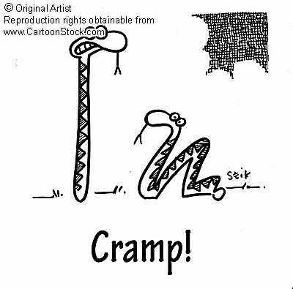
Palpation
Sports Medicine
Muscle spasm

Slide 28
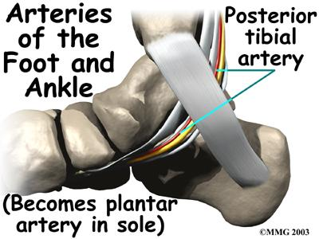
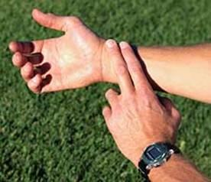
Palpation
Sports Medicine
Pulses

Slide 29
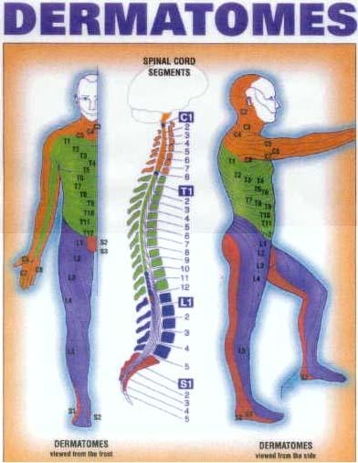
Palpation
Sports Medicine
Sensations

Slide 30
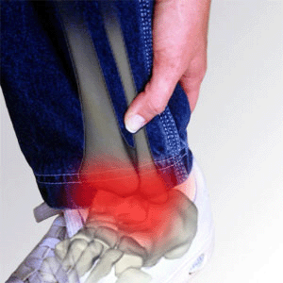
Palpation
Sports Medicine
Quality/Quantity of pain

Slide 31
Stress
Sports Medicine
Applying stress to the injured area is designed to clinically recreate the MOI NOT to make the injury worse.

Slide 32
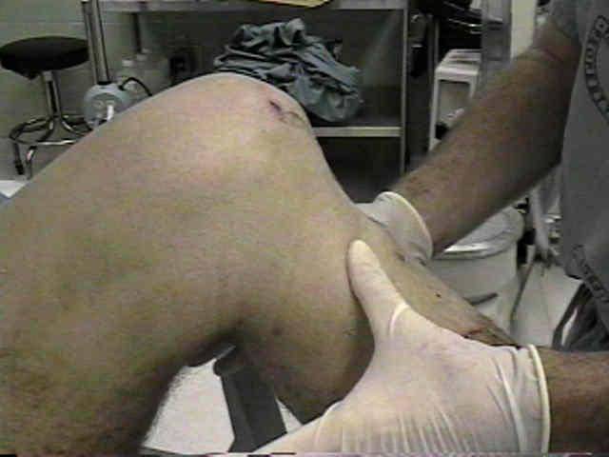
Stress
Sports Medicine
Clinical stress tests are designed to test
ligament/joint stability.

Slide 33
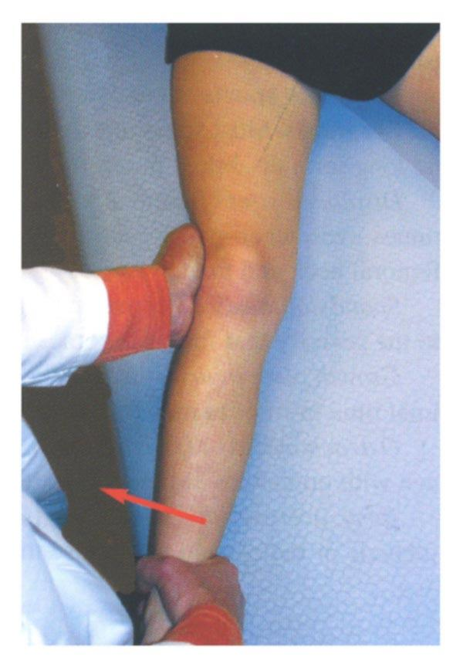
Stress
Sports Medicine
Clinical stress tests are
designed to test
ligament/joint stability.

Slide 34
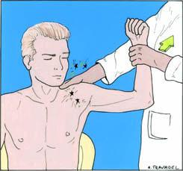
Stress
Sports Medicine
Clinical stress tests are
designed to test
ligament/joint stability.

Slide 35
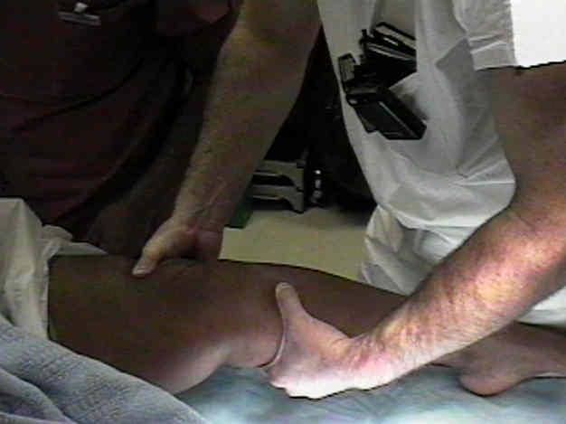
Stress
Sports Medicine
Clinical stress tests are
designed to test
ligament/joint stability.

Slide 36
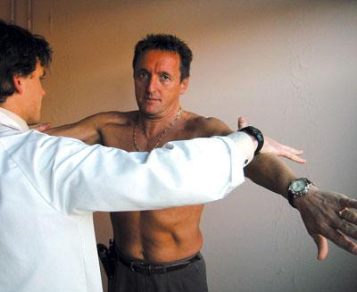
Stress
Sports Medicine
Clinical stress tests are designed to test
muscle strength and flexibility.

Slide 37
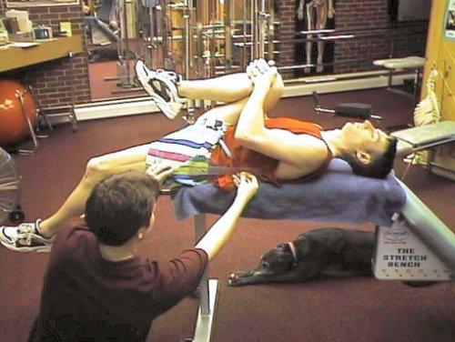
Stress
Sports Medicine
Clinical stress tests are designed to test
active, passive, and resistive ROM.

Slide 38
Remember
Sports Medicine
**Always evaluate bilaterally!**
**Always evaluate bilaterally!**

Slide 39
Individually
For the following injuries: find a scenario for how the injuries occur (history) and identify what OP will be associated with it. Then find out what a special test for identifying the injury is:
ACL tear
High ankle sprain
Meniscus tear
Torn UCL (elbow)
Torn labrum (shoulder)

